Slide 1
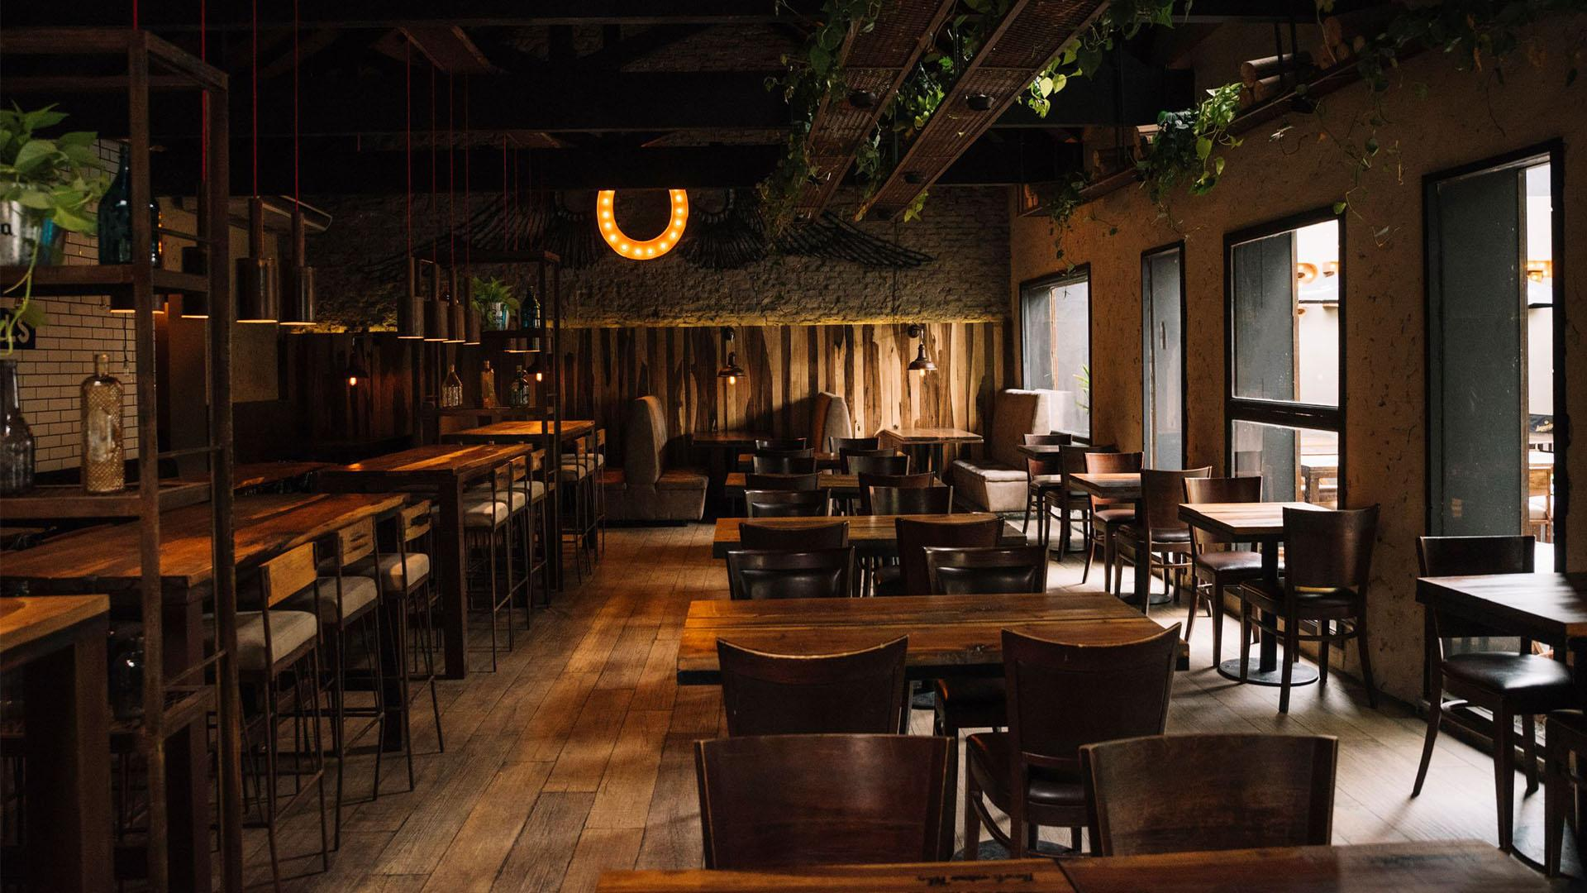
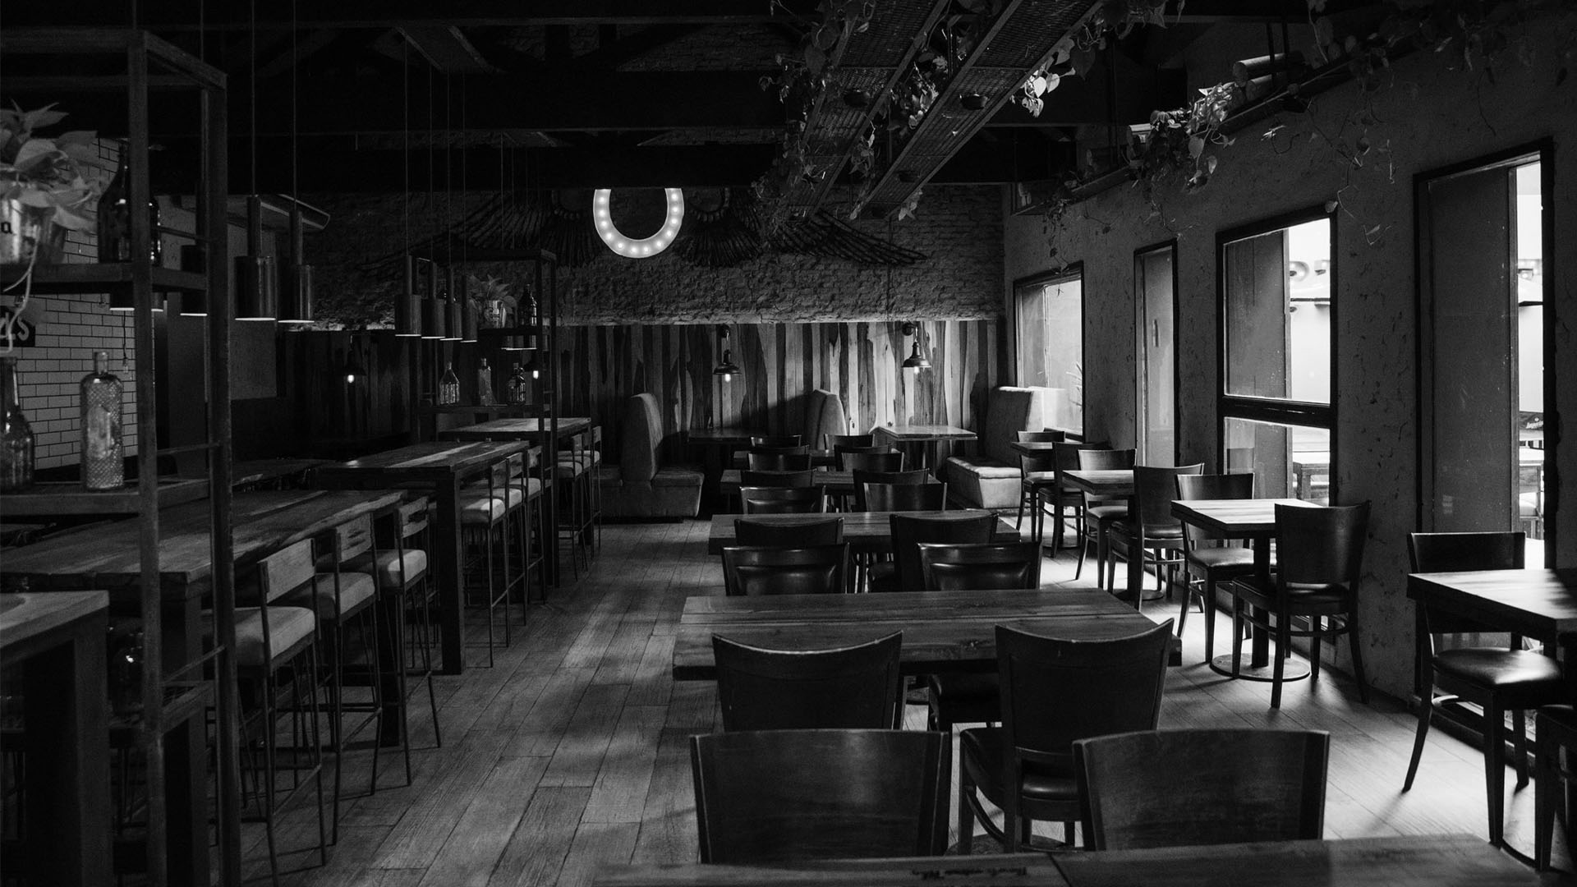
RESTAURANT DIGITAL MARKETING SOLUTION
GROUP - 1

Slide 2
TABLE OF CONTENTS
01
GENERAL DESCRIPTION
06
JIRA and GITHUB
02
USE CASE DIAGRAM
07
CLASS DIAGRAM
03
ACTIVITY DIAGRAM
08
PROJECT SCHEDULING
04
USER INTERFACE
09
PROJECT ESTIMATION
05
USER STORY CARD
10
CONCLUSION

Slide 3

01
GENERAL DESCRIPTION
Consulting and giving proper elements and plan about marketing digitally.

Slide 4
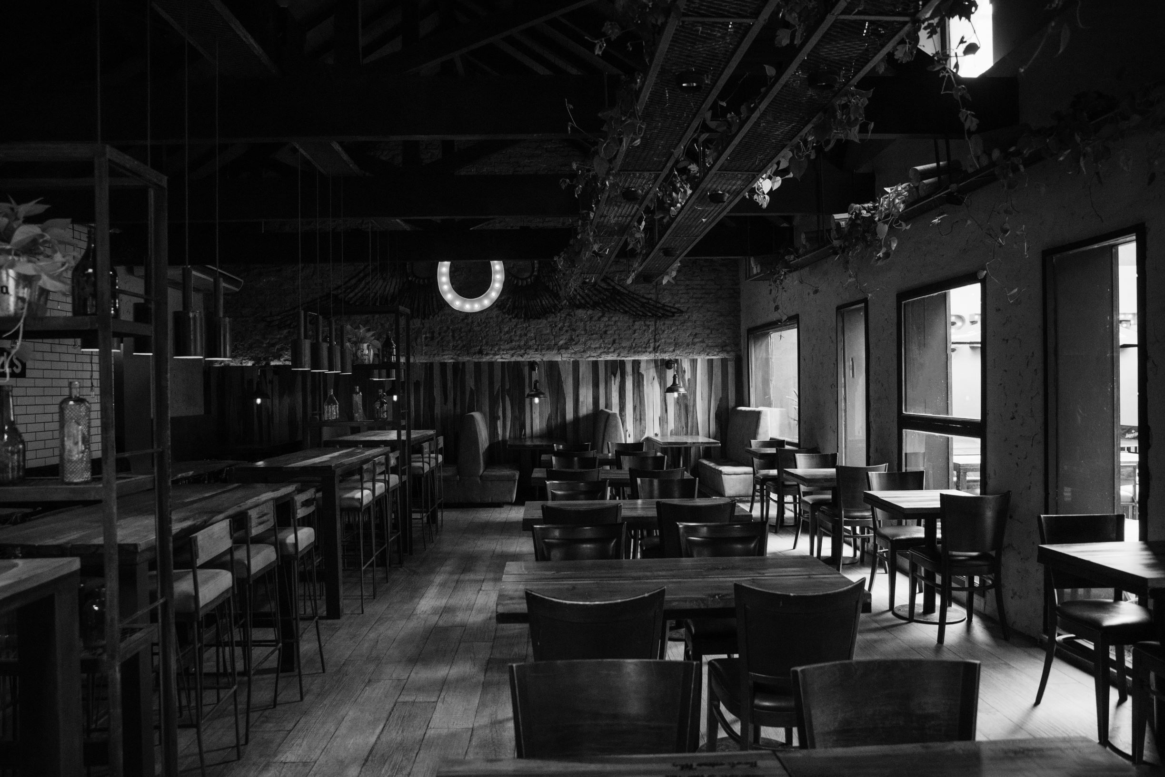
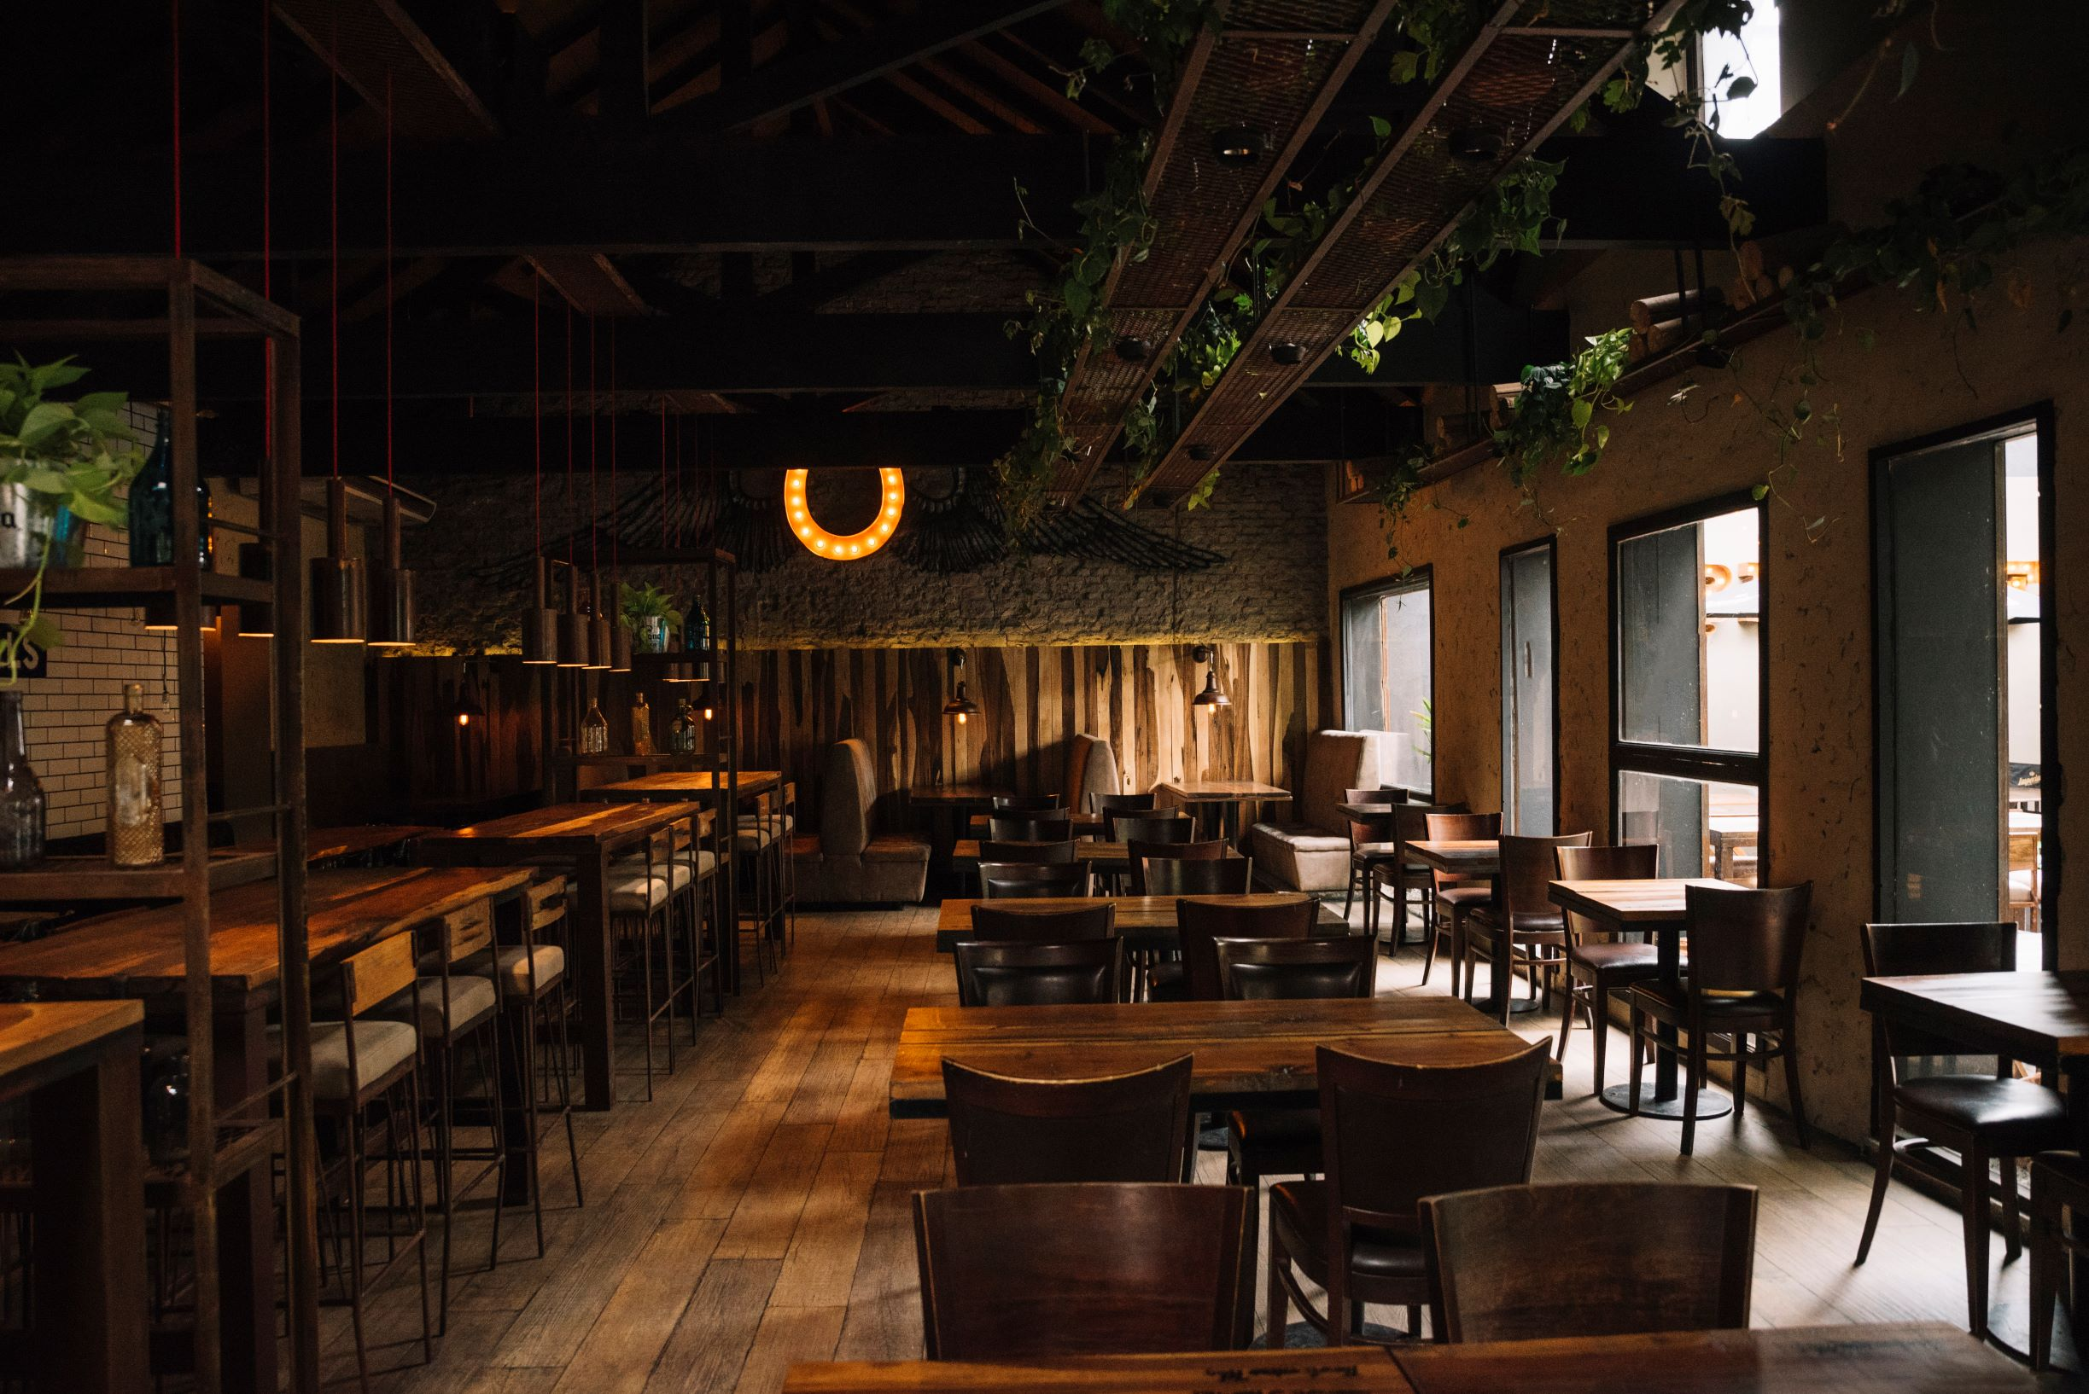
TARGET AUDIANCE
The intended audience for the software will be restaurant owners who are not sure what should be the best marketing decision for the restaurant.

Slide 5
PROBLEMS & OPPORTUNITIES
PROBLEMS
OPPORTUNITIES
People are not used to this kind of plan in Bangladesh region
Overcome the issue with the possible best and realistic solution

Slide 6
BASIC FUNCTIONALITY
DESIGN
ADVERTISING
i. Logo
ii. Website
iii. Interior
iv. Menu
i. Social Media Advertisement
ii. E-mail Advertisement
iii. Affiliate Marketing

Slide 7
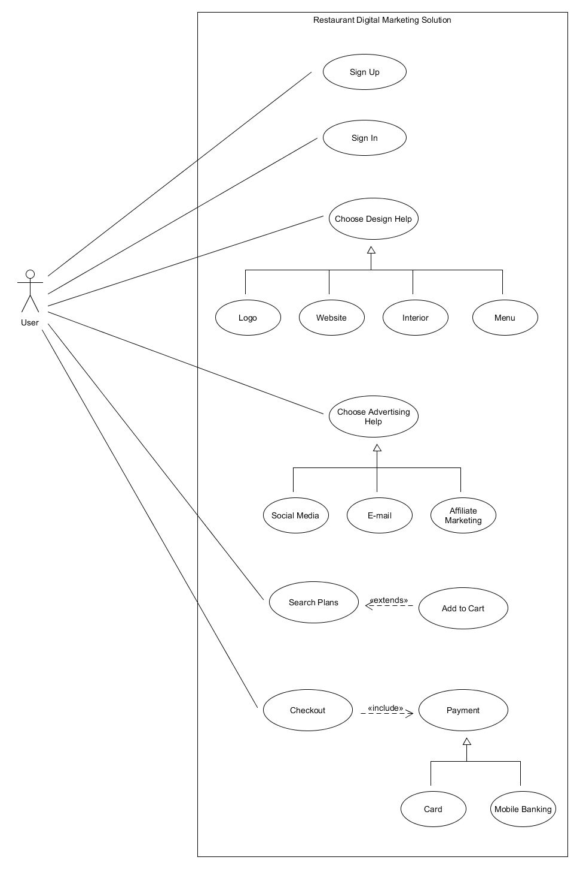
02. USE CASE DIAGRAM

Slide 8
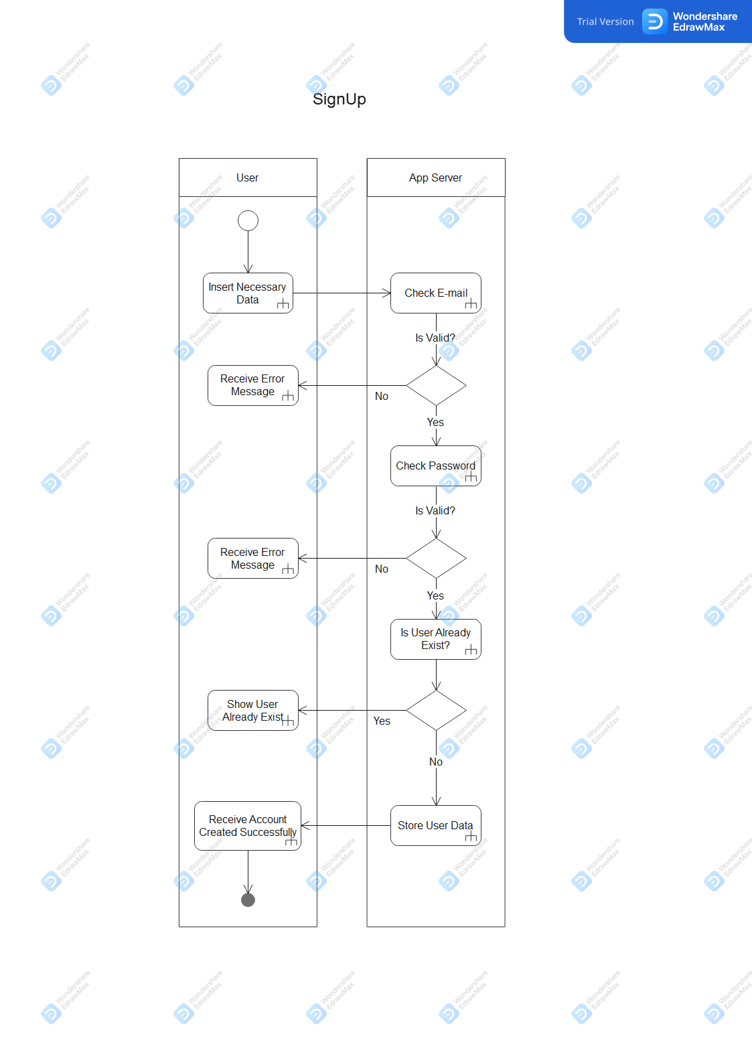
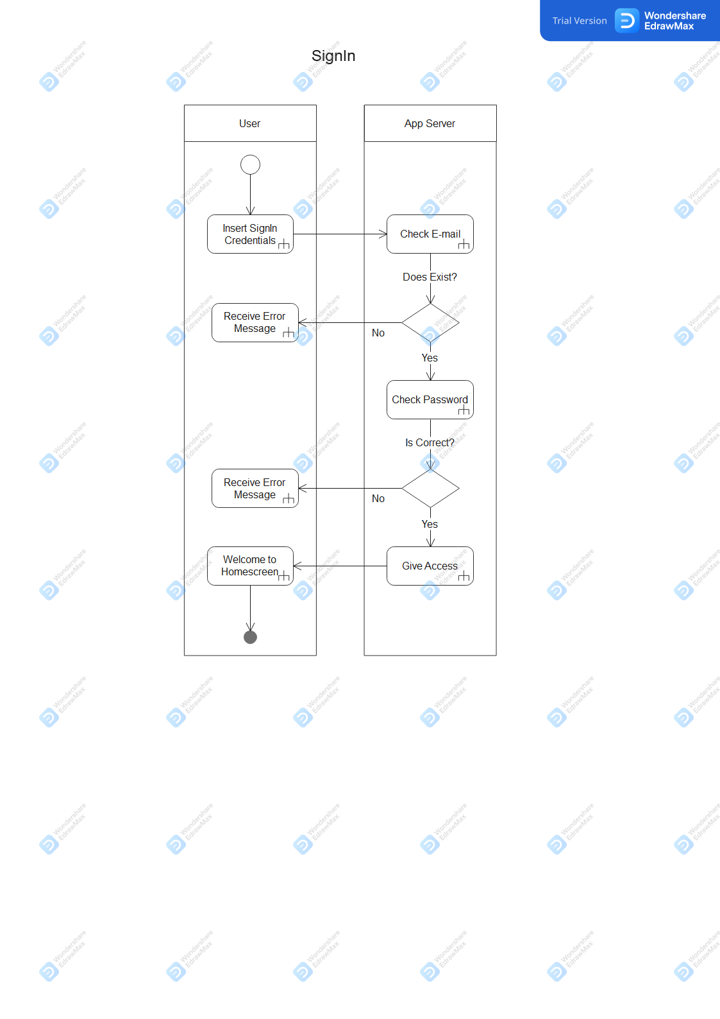
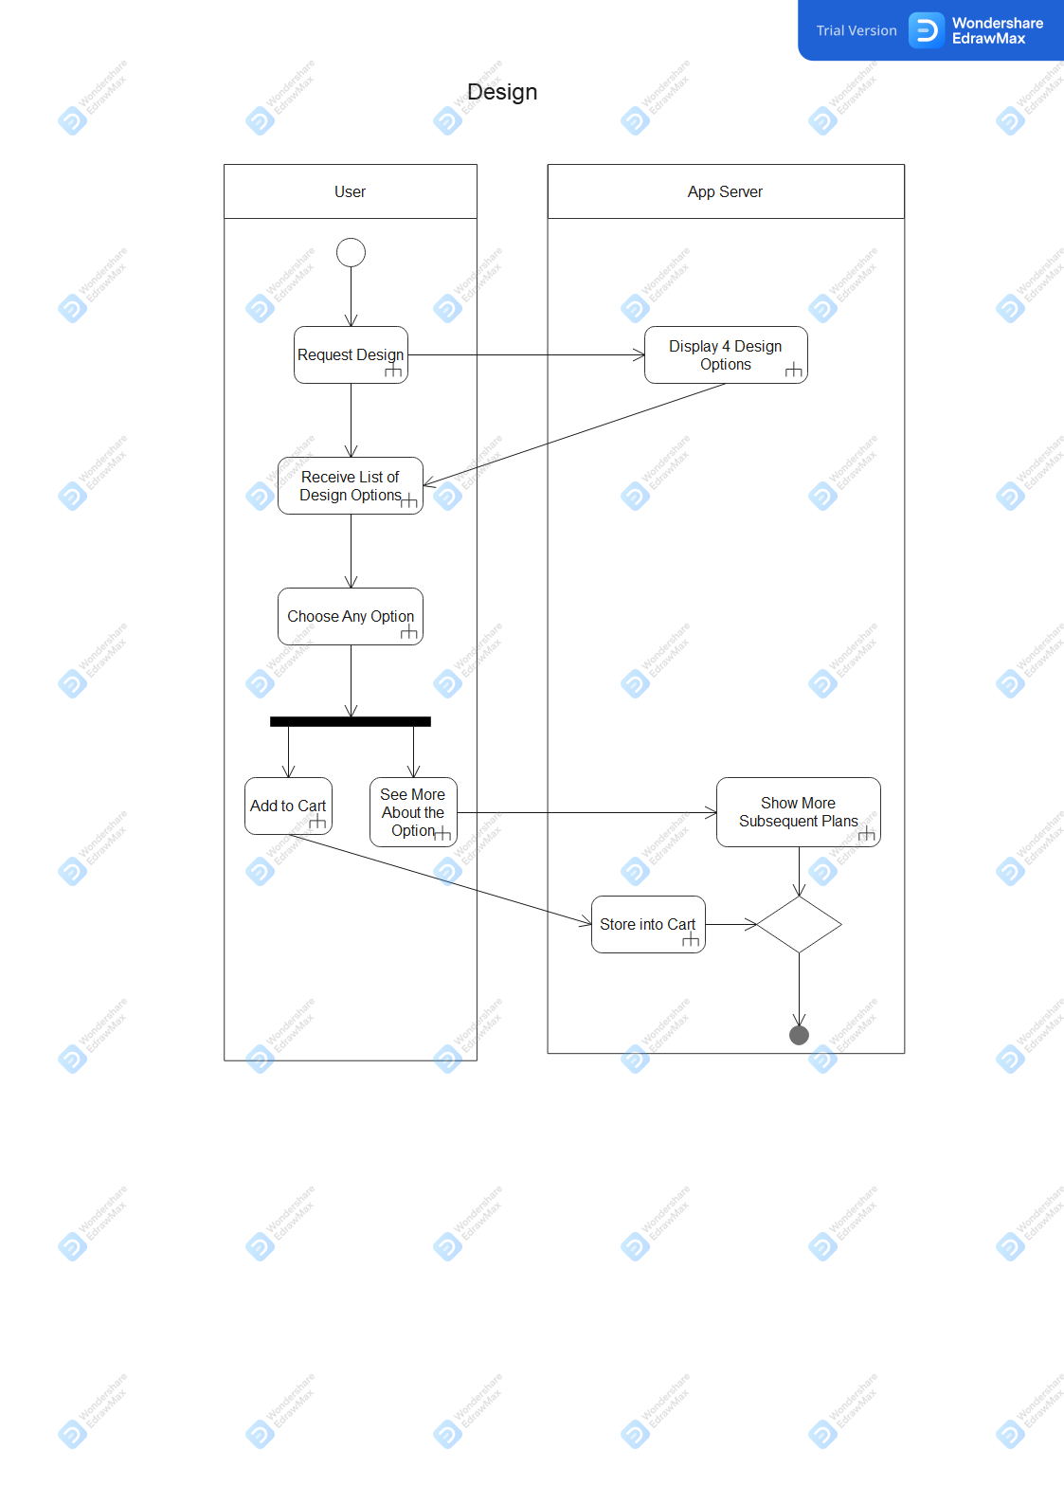
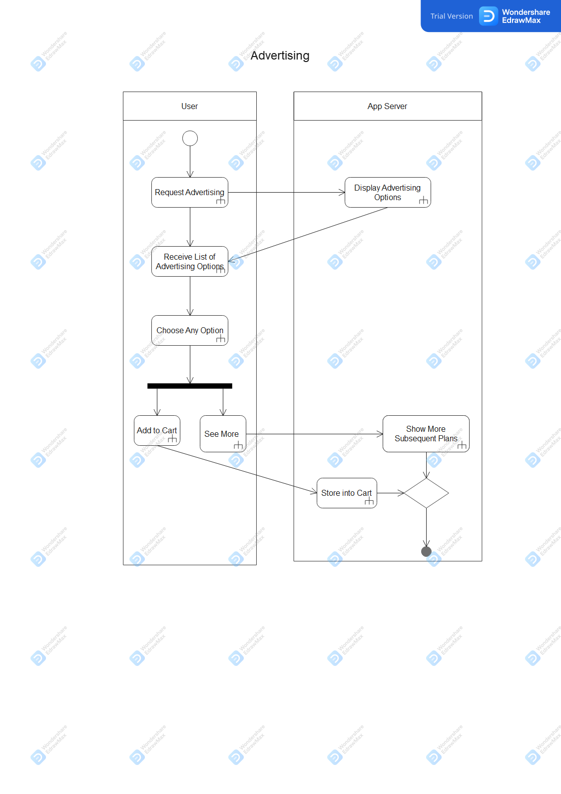
03. ACTIVITY DIAGRAM

Slide 9
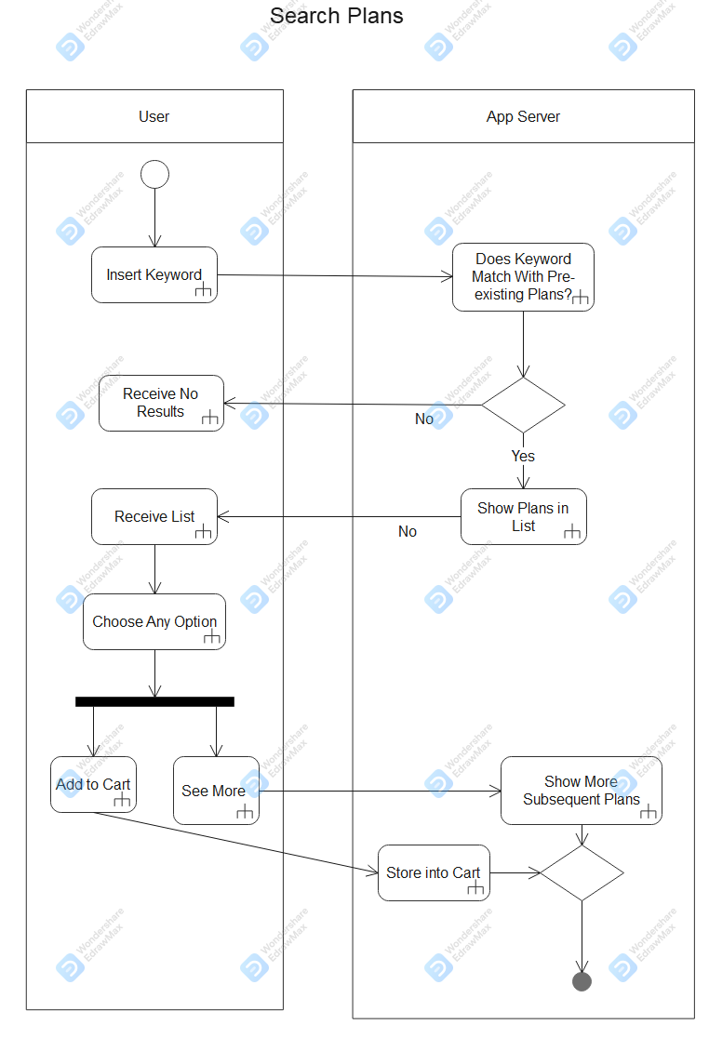
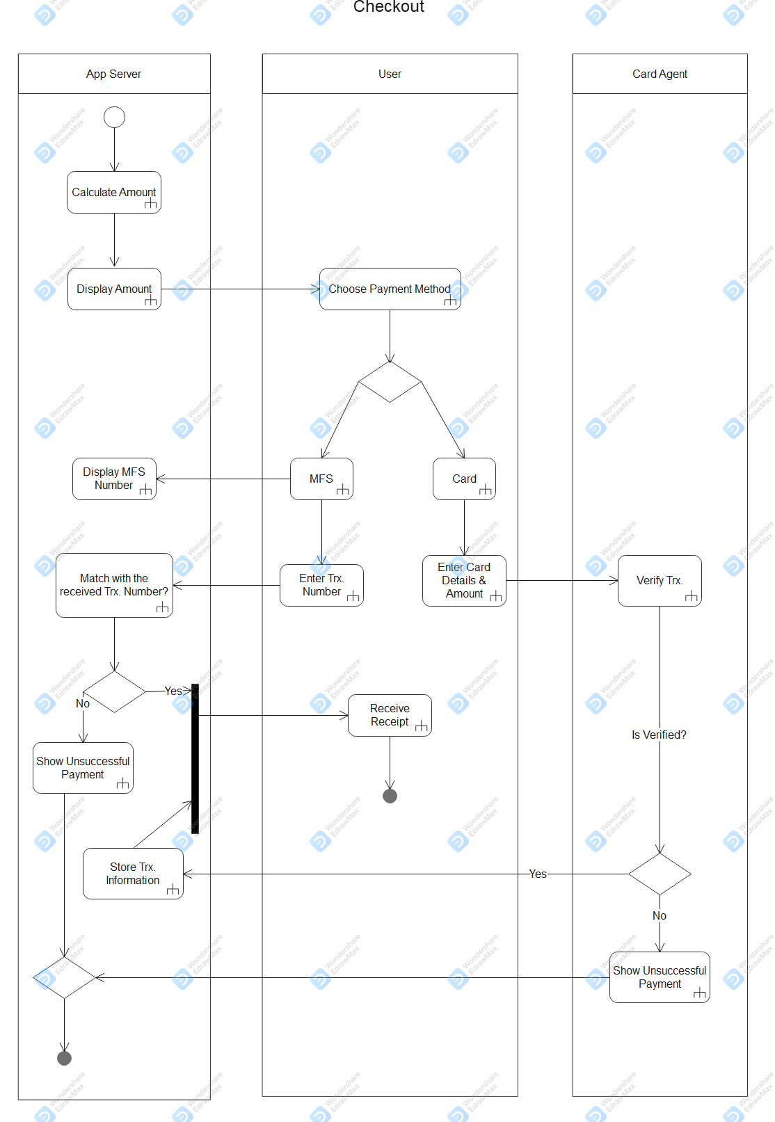
03. ACTIVITY DIAGRAM

Slide 10
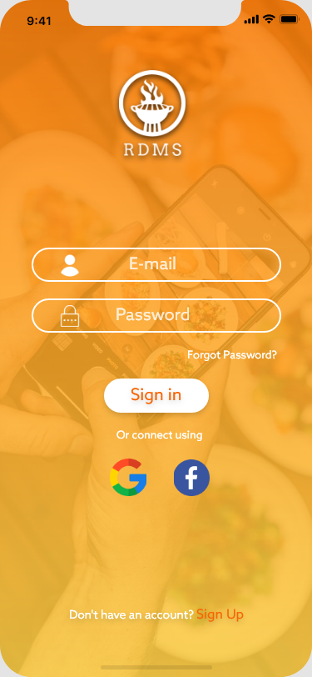
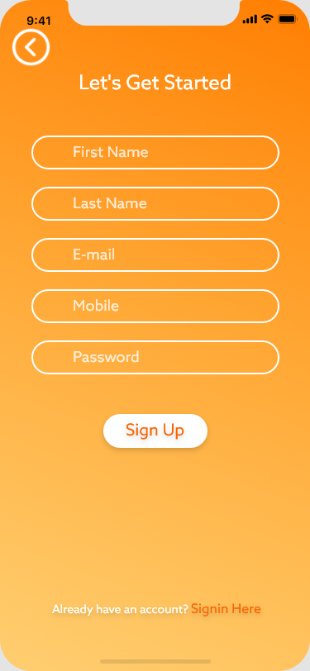
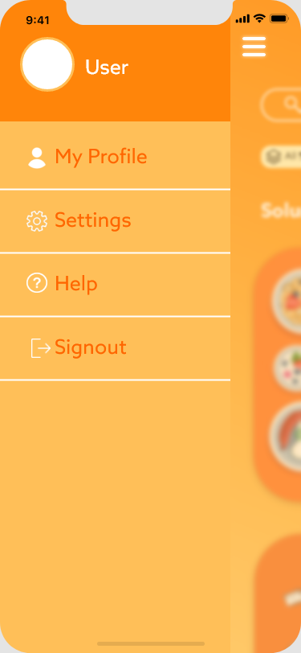

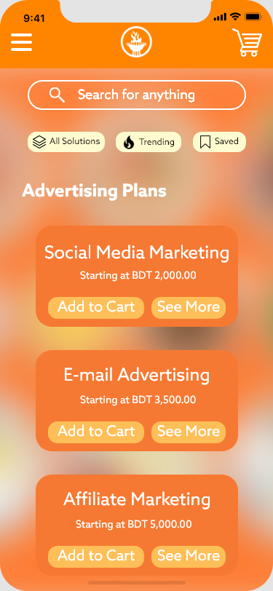
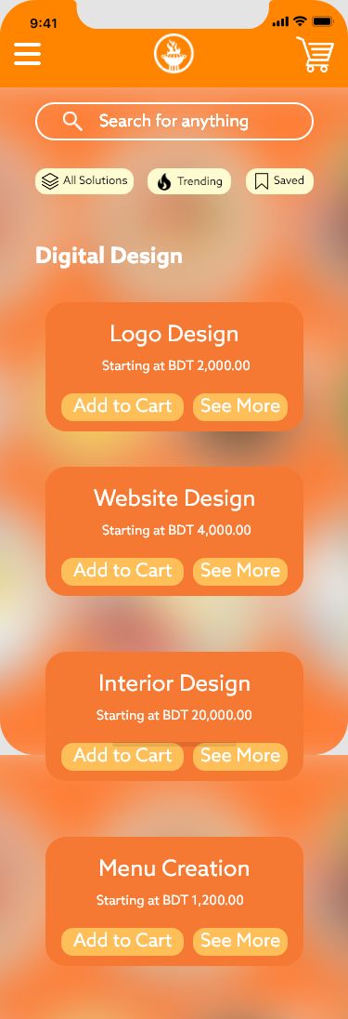
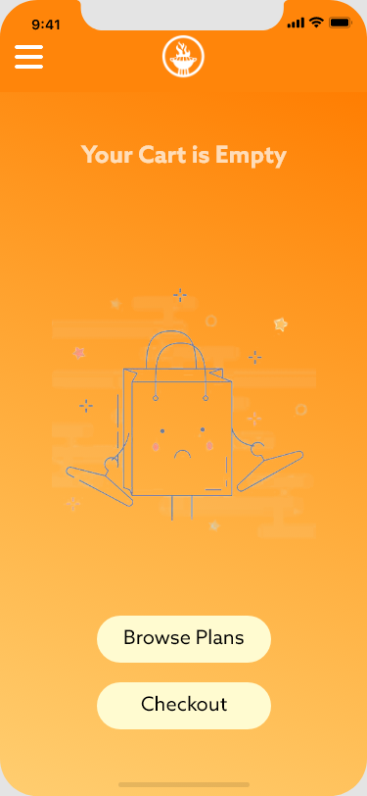
04. USER INTERFACE

Slide 11
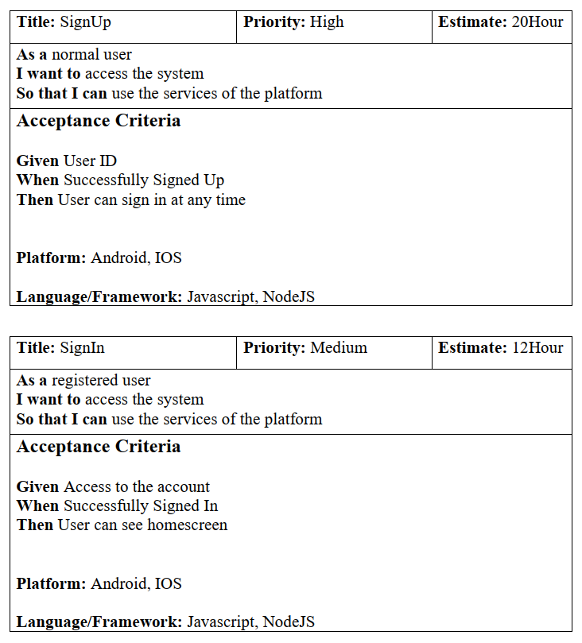
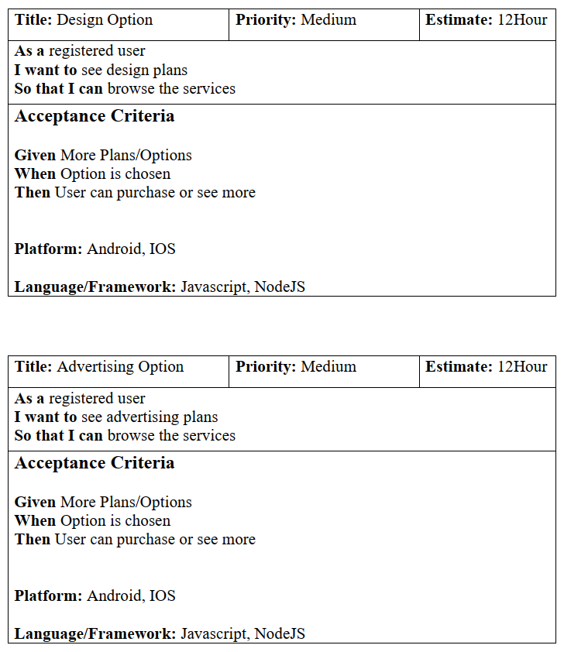
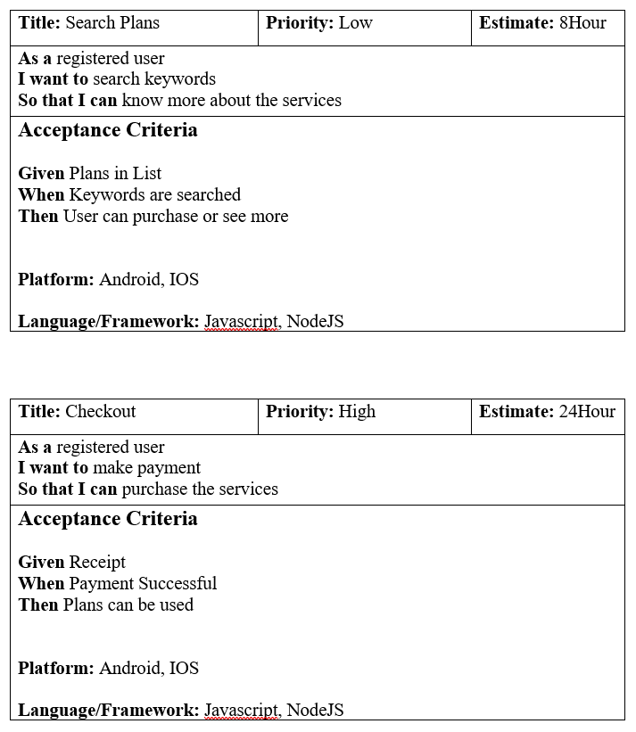
05. USER STORY CARD

Slide 12
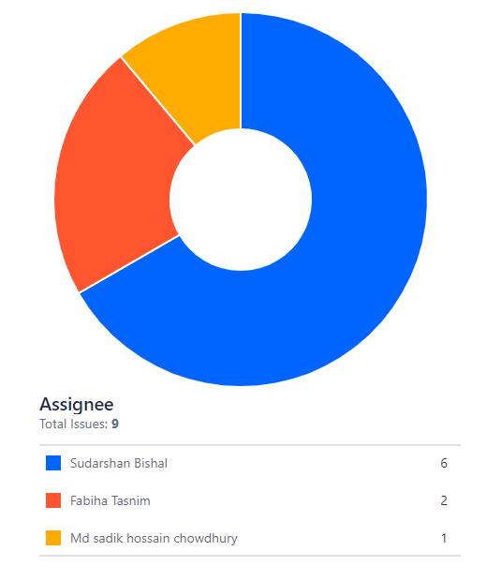
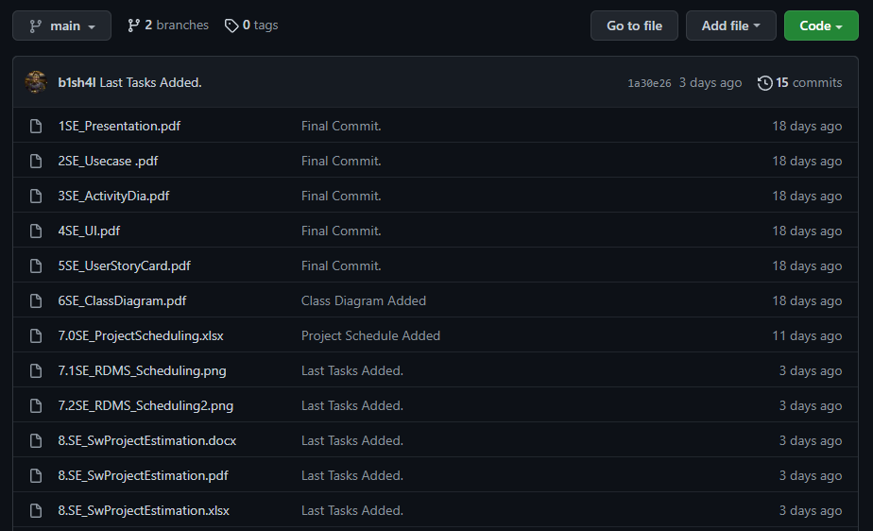
06. JIRA and GITHUB
JIRA
GITHUB
Repository Link: https://github.com/b1sh4l/RDMS

Slide 13
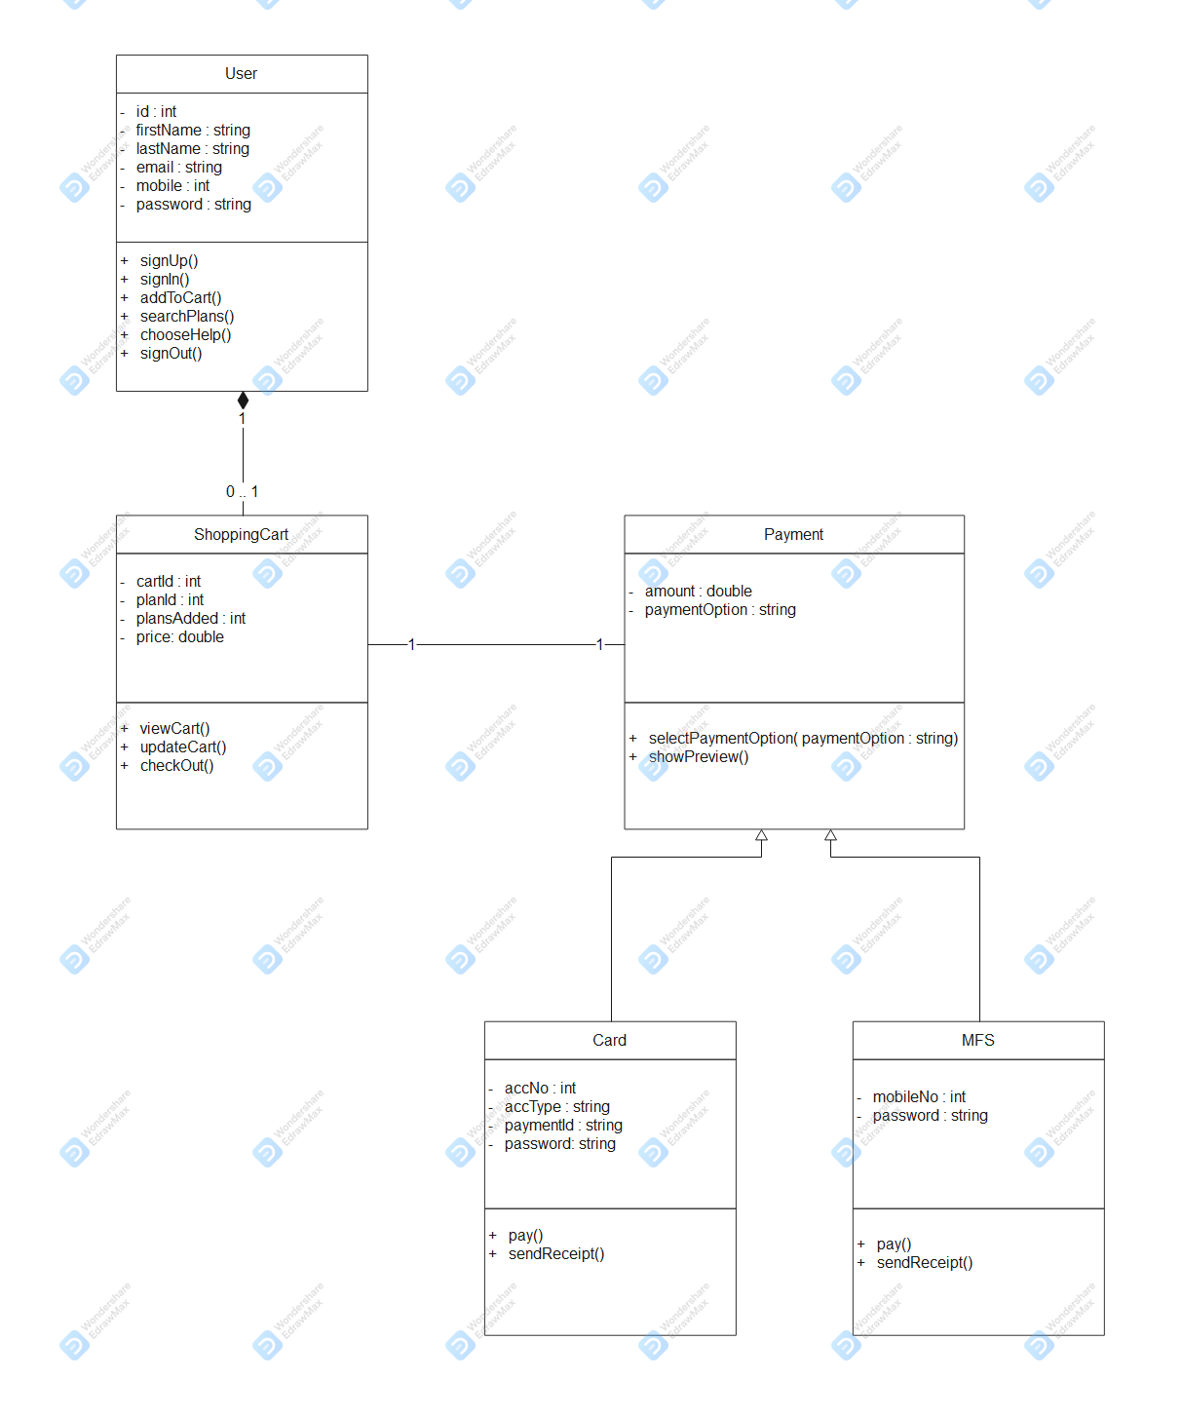
07. CLASS DIAGRAM

Slide 14
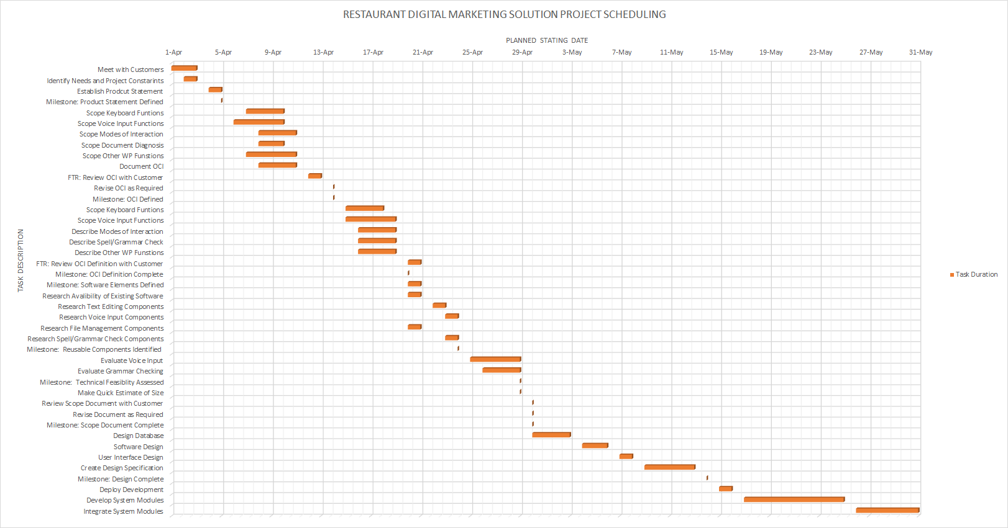
08. PROJECT SCHEDULING

Slide 15
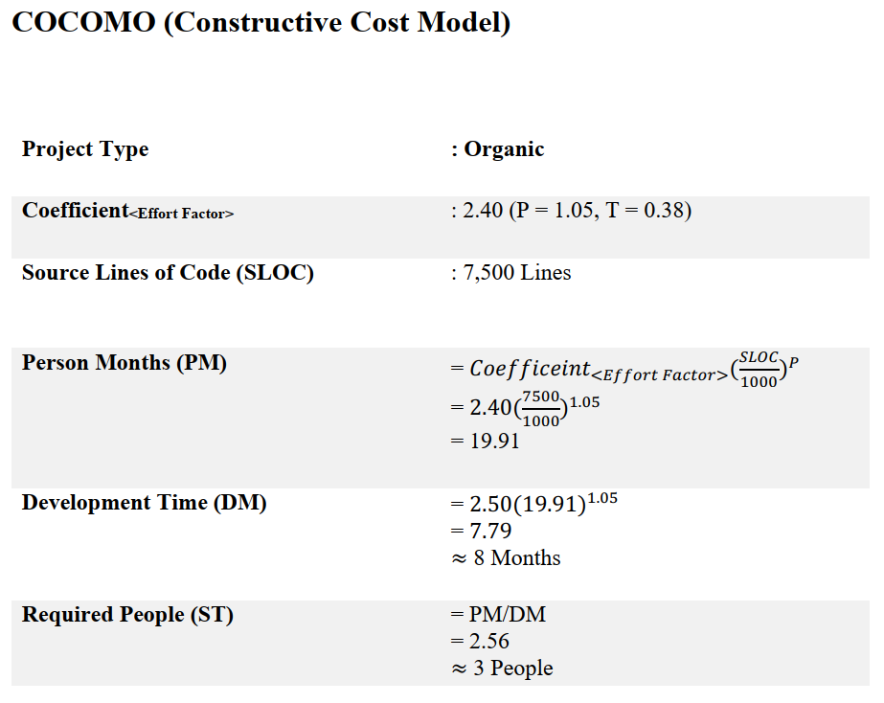
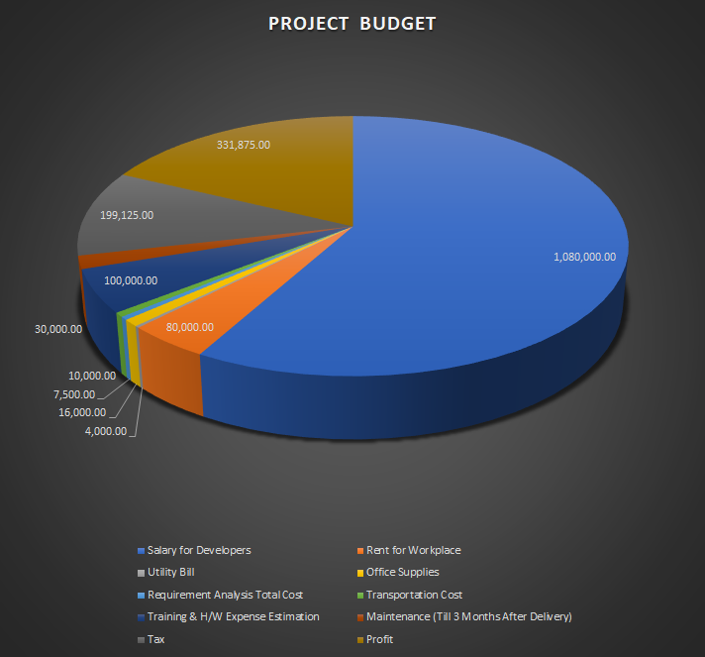
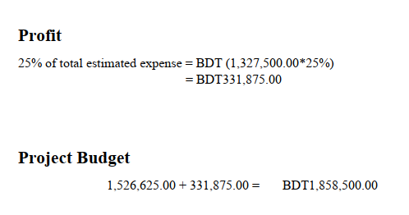
09. PROJECT ESTIMATION

Slide 16
10. CONCLUSION
Risk Factors : Lack of Interesting Plans
Project Development Duration : 2 Months
Budget : BDT 1,858,500.00

Slide 17
THANK YOU
BISHAL, SUDARSHAN SAHA
TASNIM, FABIHA
CHWODHURY, MD SADIK HOSSAIN

